Slide 1

Database Project
Authors:
Younghan Jo
Junglim Kim
Eui Yong Felix Kim
Sandeep Singh Saini
Aaditya Shah
Viktor Salnichenko

Slide 2
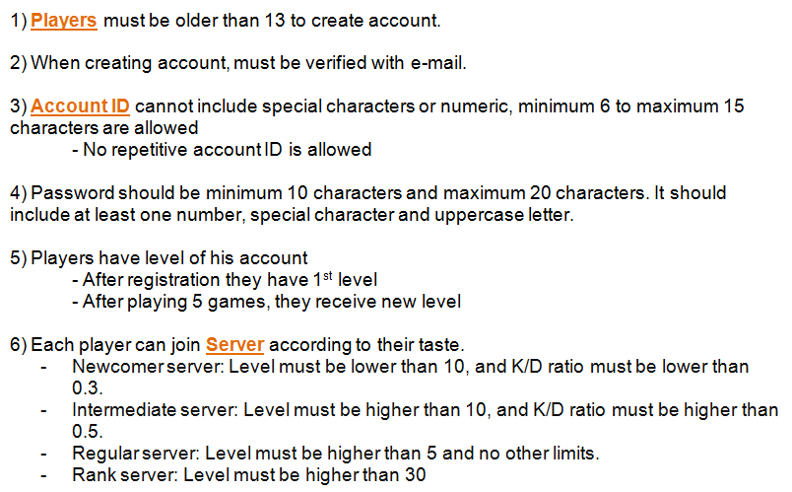
Business Rules

Slide 3
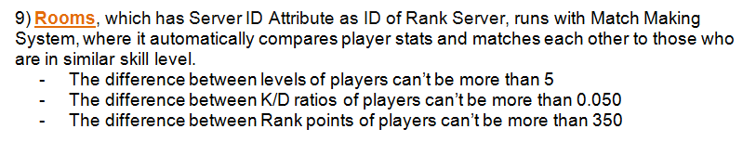
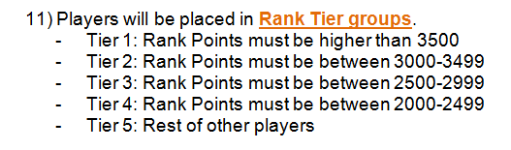
Business Rules

Slide 4
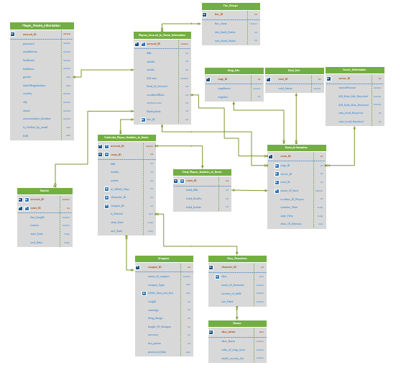
Entity Relationship Diagram (ERD)

Slide 5
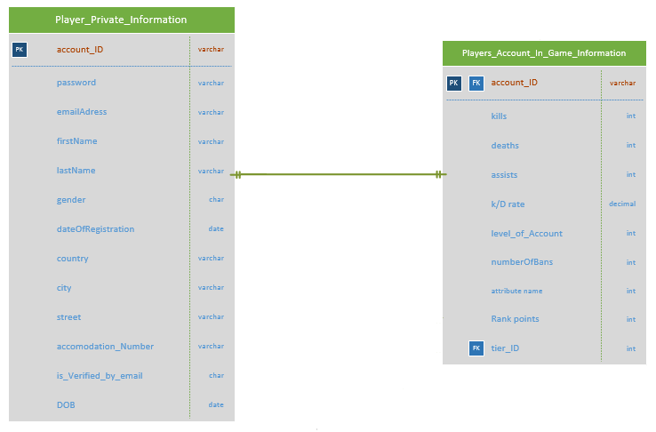
Entity Relationship Diagram (ERD)

Slide 6
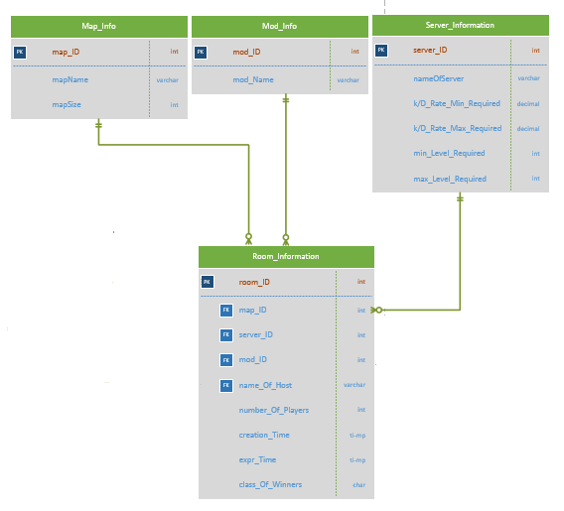
Entity Relationship Diagram (ERD)

Slide 7
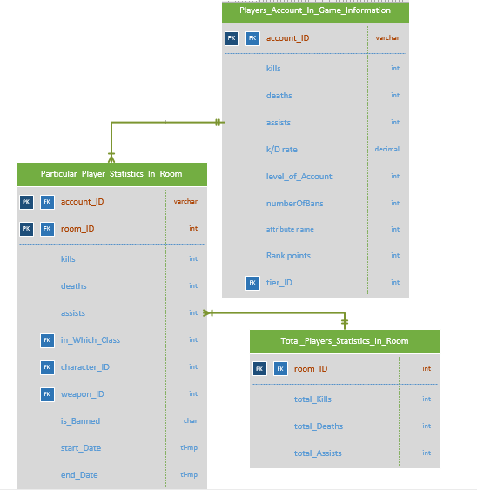
Entity Relationship Diagram (ERD)

Slide 8
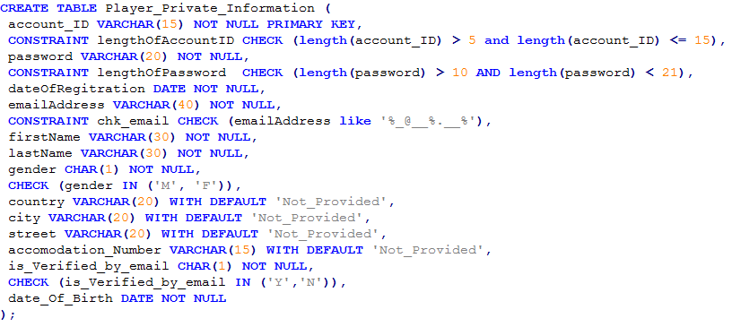
DDL (Tables in IBM DB2)

Slide 9
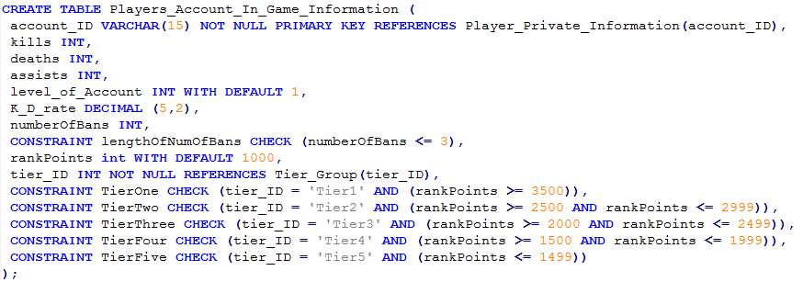
DDL (Tables in IBM DB2)

Slide 10
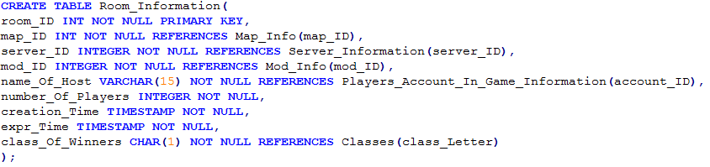
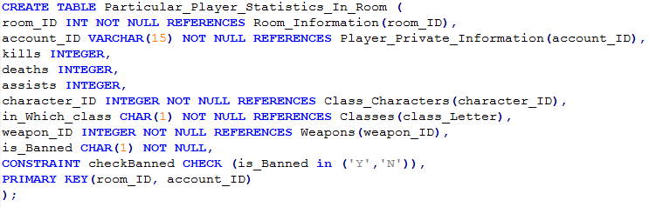
DDL (Tables in IBM DB2)

Slide 11
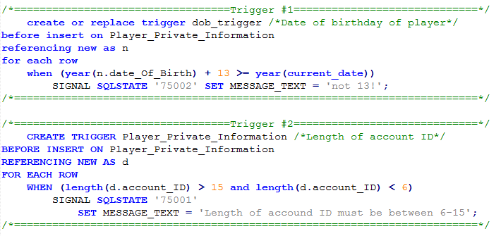
Triggers

Slide 12
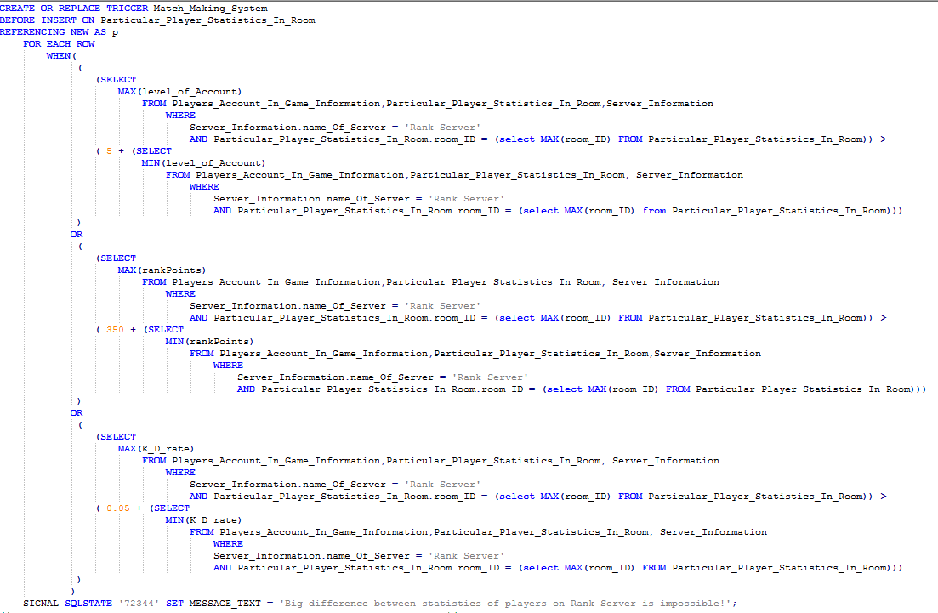
Triggers

